Slide 1
Olafs Adventure
Leonie, Marco, Harald, Rene, Philipp

Slide 2
Gameplay
primary loop:
manipulate the gravity of things
don‘t die
secondary loop:
reach the end of each level
collect all keys/solve the riddles
tertiary loop:
escape the maze
get achievements/highscores

Slide 3
Motivation
story:
Olaf (player) wakes up in a maze, no memory of what happend and somehow unable to move his body
a god like voice (guide or storyteller) explaines what has happened and what to do (also gives occasionally tips)
Olaf navigates through the maze only capable to manipulate the gravity of all lose objects in the room (maybe an extra seperation between living and dead things depending on the room (open idea, not yet decided if))
possible ending -> waking up from a dream

Slide 4
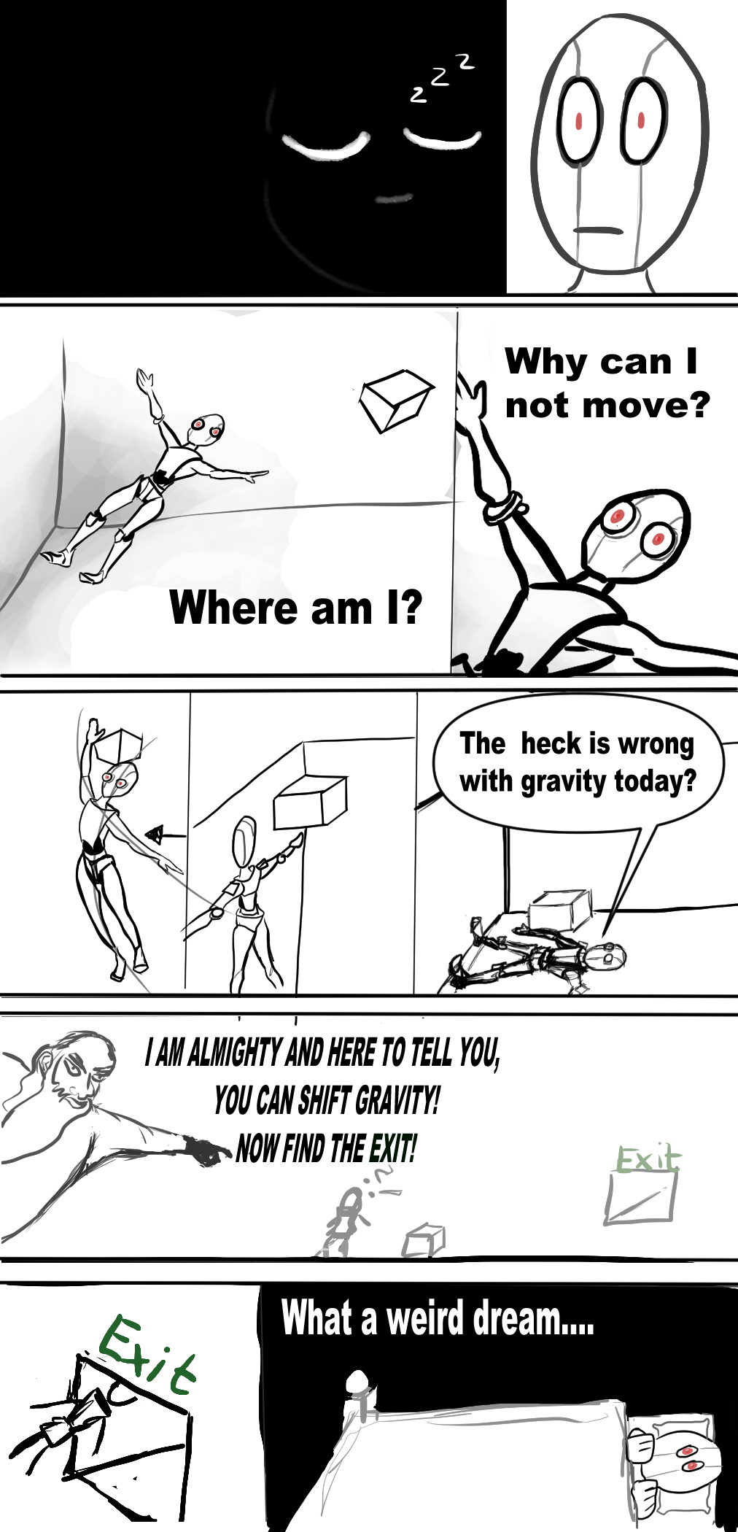

Slide 5
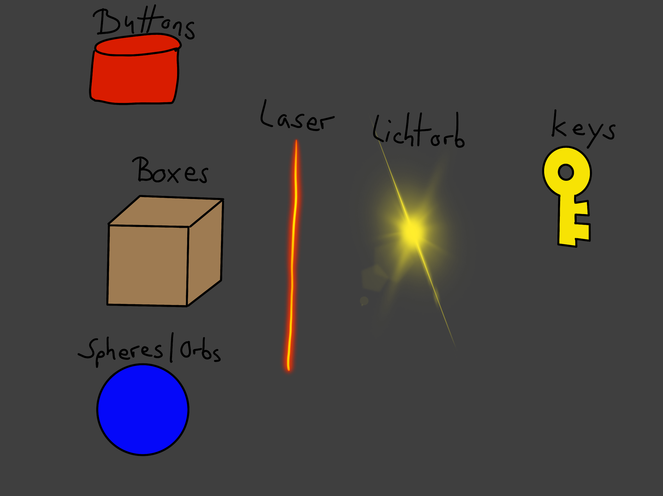
Ideas for assets
buttons
boxes
lasers
ligthorbs
spheres
springs/pistons
keys
furniture
…

Slide 6
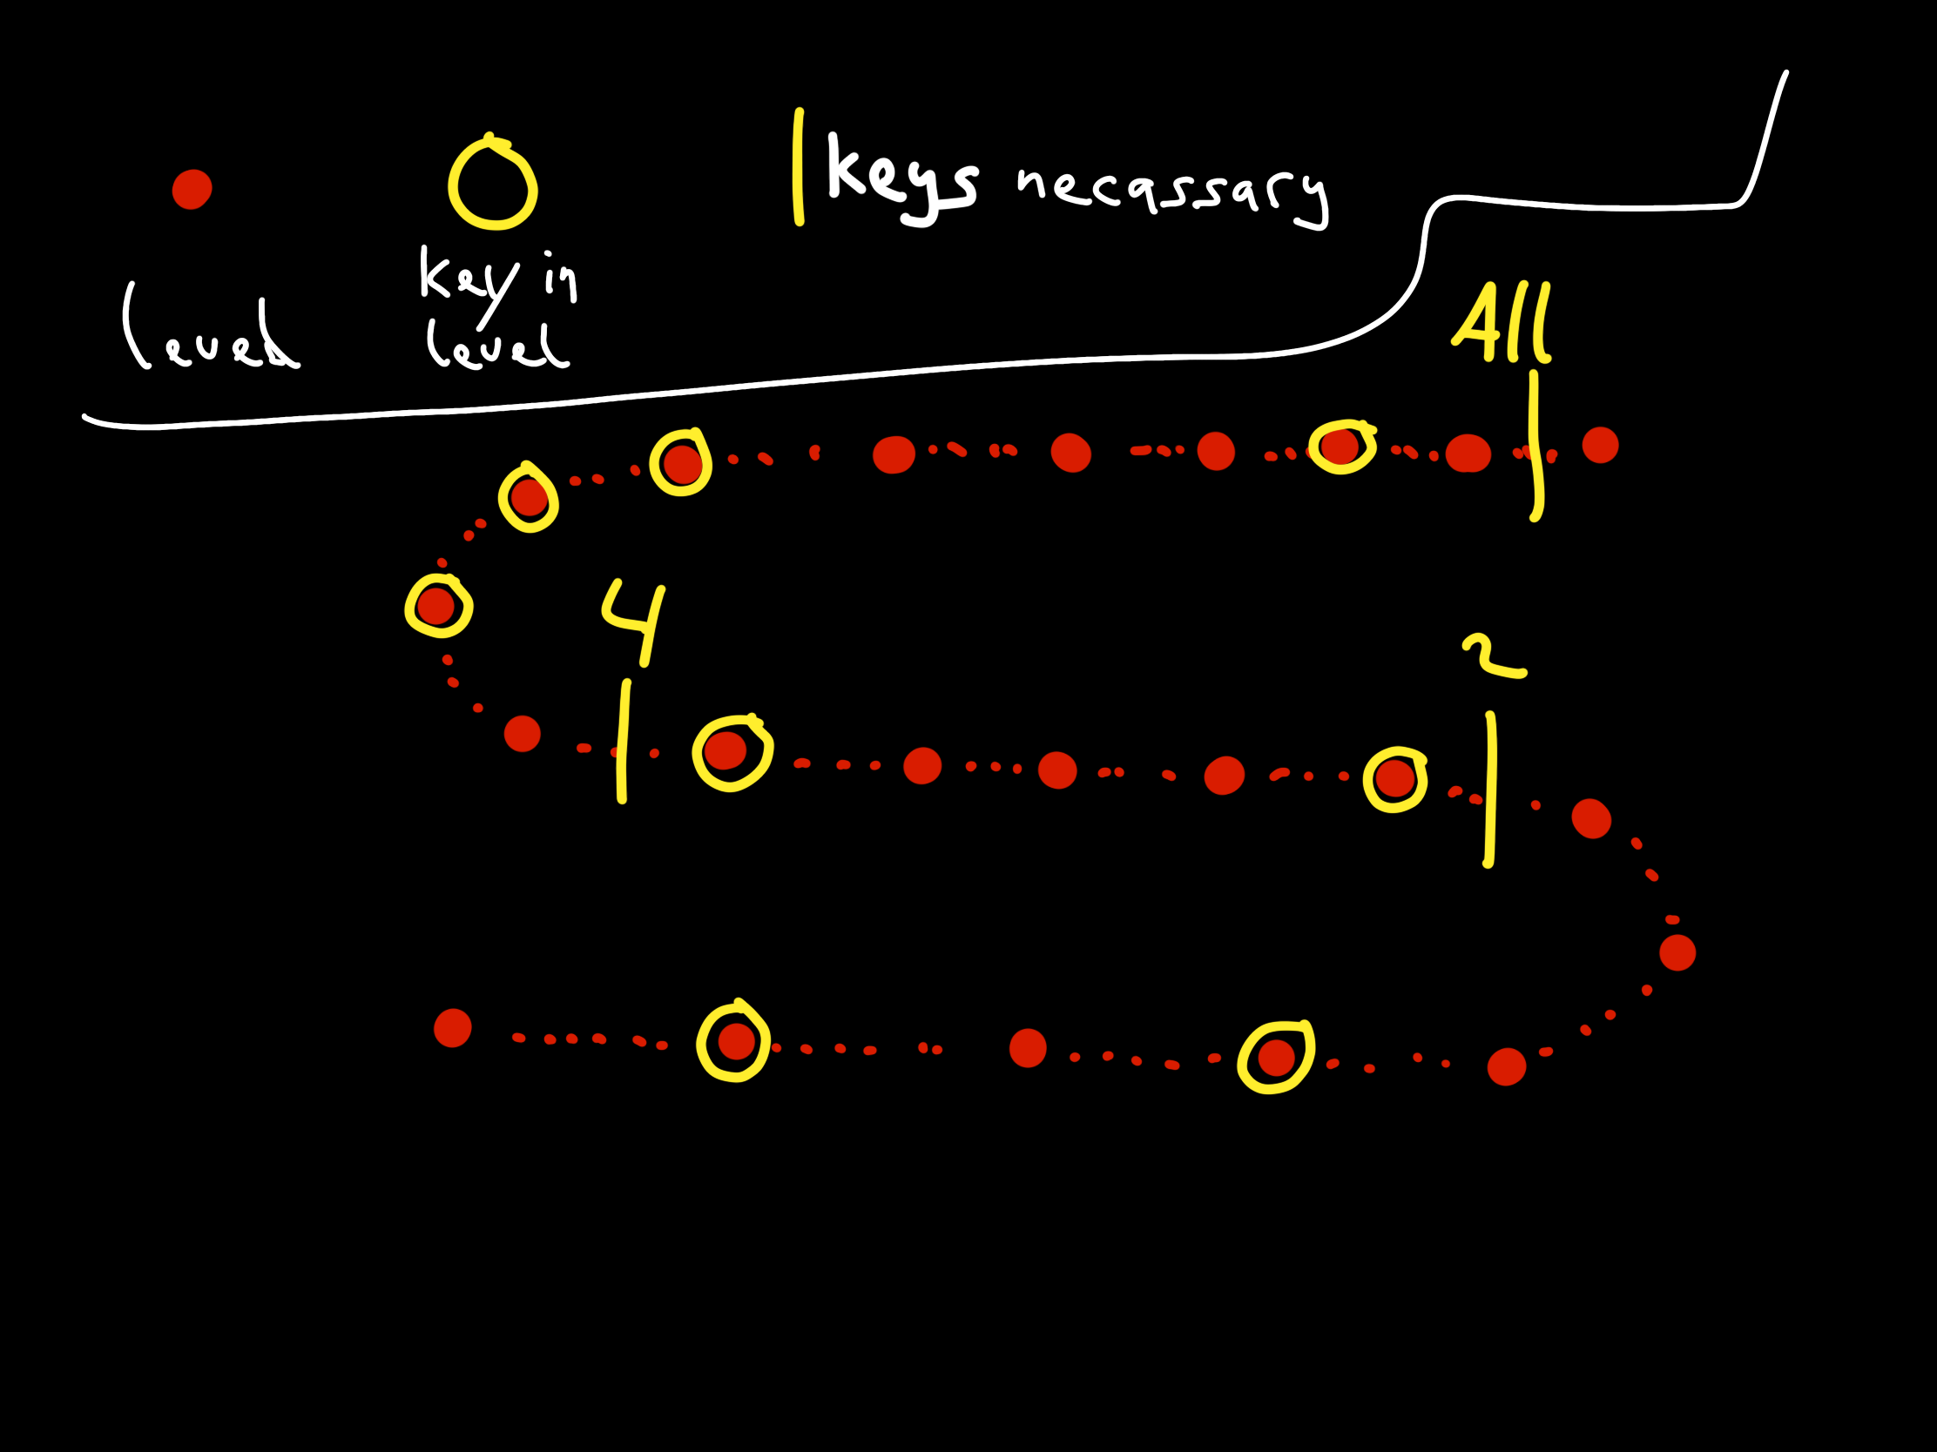
possible level design
1 room = 1 level
several levels = 1 stage
stages are divided through tasks like having all keys to that point or having solved an extra riddle
once a room is cleared it can be revisited
then all level are cleared the story concludes an the game is won

Slide 7
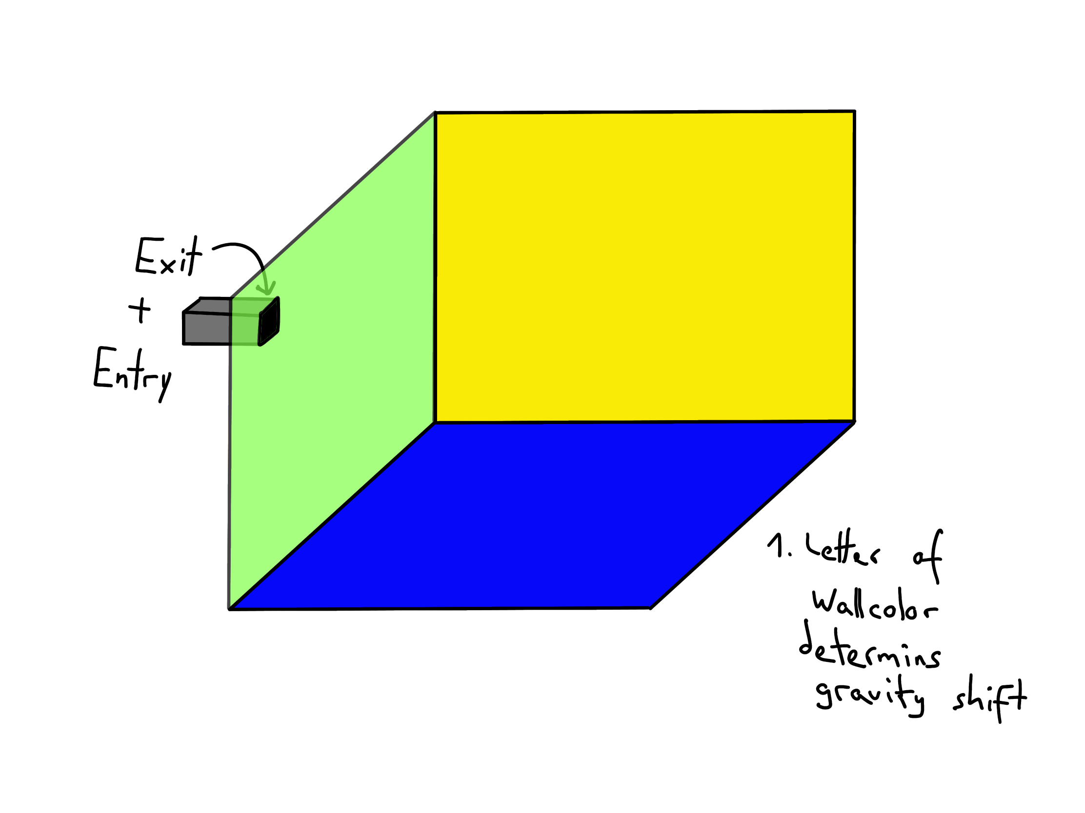
general room and movement
the mechanic for changing gravity isn‘t final yet, possibilities:
colored walls -> first letter of color is the button which shifts gravity towards that wall
compass gets displayed at one corner to give an orientation -> w,e,n,s as well as u for up and d for down will change the gravity
currently in testing/use : 1.

Slide 8
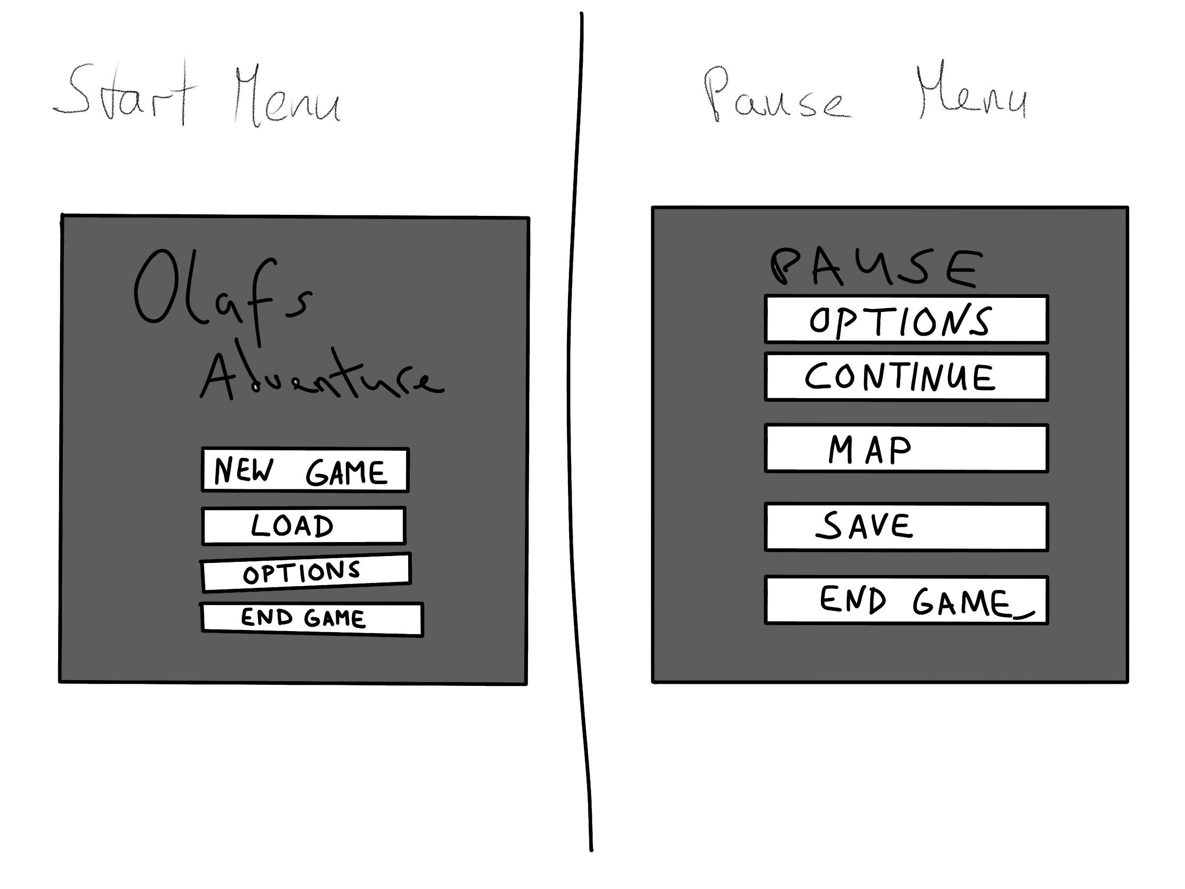
Other aspects and/or mechanics
room change goes according to story either through fade out fade in with a teleport or through active loading when in certain area (new room loads old room gets erased/unloaded)
General layout would be a simple start menu and a pause menu with access to a map and the general options

